Slide 1

Single-Shaft Rotary Sifter
Questions and responses
Confidential

Slide 2
1 of 2
1
Sampling point
The sifter has no sampling port. Samples can be taken from a continuous plastic liner, or from the packaged FIBC (ton bag).
2
How is oxygen measured?
A fixed oxygen analyzer is installed on the unit and can be read directly. An oxygen interlock stops the equipment automatically when the reading exceeds the set point.
3
How is temperature monitored?
This equipment has no temperature monitoring.
4
How is weighment done?
A platform scale is tied into the PLC. When the weight reaches the set point, the discharge valve closes and the unit stops automatically.
For GG917, the target fill is ~7 kg per bag. The scale can be set to 7 kg to meet the packaging weighment.
Confidential

Slide 3
2 of 2
5
Connect to the filter-dryer (AFD) if possible
1. Current vertical headroom does not allow a direct connection.
2. Planned transfer: AFD discharge → Flexible Intermediate Bulk Container (FIBC) or single-use charging bag → sifter inlet. See the flow diagram.
6
The mill / sifter does not look suitable for a clean area
The sifter includes feed and discharge control, oxygen monitoring, and weighment, so the electrical cabinet is large. The design will be optimized later.
7
P&ID: can it be cleaned, and is it sanitary?
No automatic CIP. The unit can be stripped and cleaned manually. Product-contact metal is 316L; seals are PTFE. These materials meet cleanliness requirements.
Confidential

Slide 4
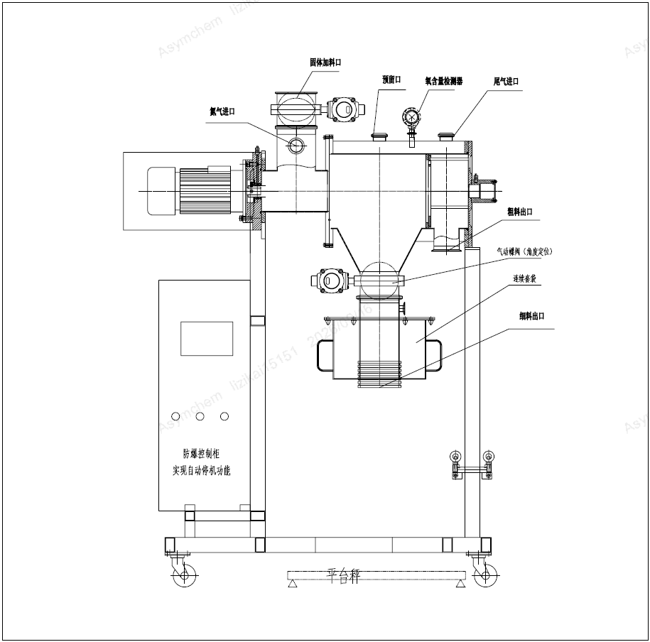
Function ports
English key to the drawing
On the drawing | English
固体加料口 | Solids feed
预留口 | Spare port
氧含量检测器 | Oxygen analyzer
氮气进口 | Nitrogen inlet
粗料出口 | Coarse / overs outlet
气动阀（角度定位） | Pneumatic valve (indexed)
连续套袋 | Continuous liner
细料出口 | Fines outlet
防爆控制柜 / 自动停机 | XP cabinet / auto-stop
平台秤 | Platform scale
Confidential

Slide 5
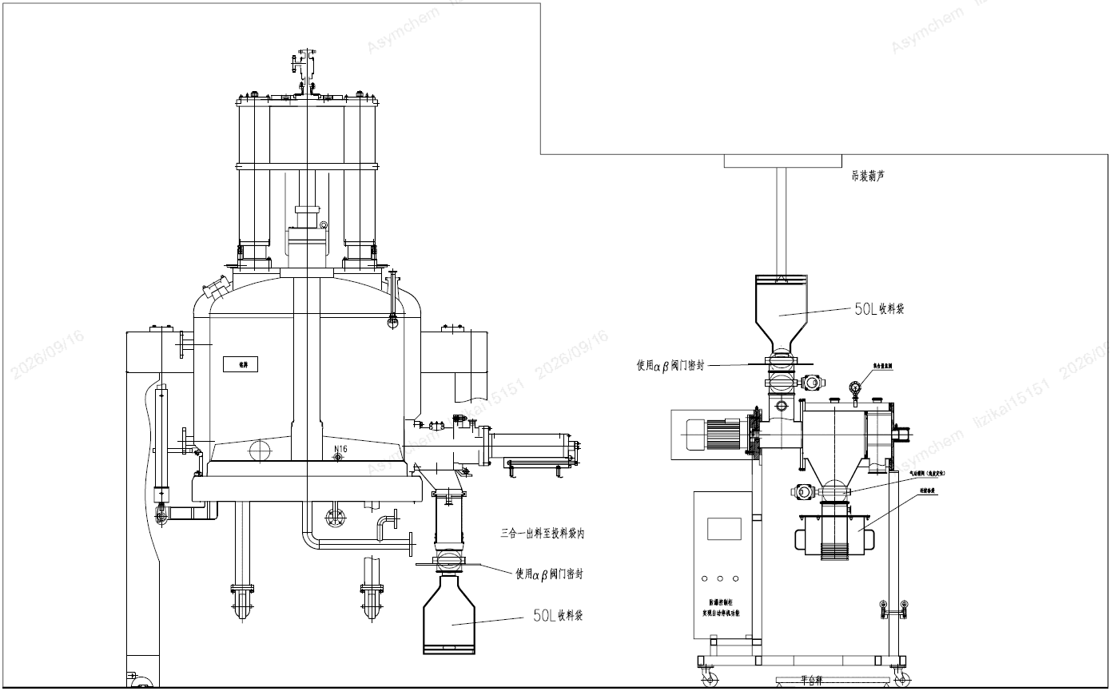
Transfer: filter-dryer → sifter
Intended sequence
1. Filter-dryer discharges into a 50 L charging bag, sealed with an αβ valve.
2. The bag is moved to the sifter inlet.
3. The bag is docked to the sifter with an αβ valve and emptied into the solids feed.
4. The sifter sits on a platform scale for bag weighment.
Confidential

